Slide 1
The Introductory Page
If you don’t tell the jury what you are exhibiting, don’t expect them to work it out for themselves ...
Chris King
The Sun Hotel
Hitchin 25-26 November 2016

Slide 2
The Introductory Page
Jurors get this in advance to do their homework
Exhibitors should do what works for them, but the exhibit must be clear and structured. There are no absolute rules
The key is to capture the interest of the viewer or juror.
A clear simple front page and presentation goes a long way to achieving this.

Slide 3
The Introductory Page
  Structure: Explain how the exhibit is organised: How has the story been told?
  Background: A short historical context.
  Conventions: Standard abbreviations, use of text, graphics etc.
  An Image: such as a map, or a key item: attracts attention to the exhibit.

Slide 4
The Introductory Page
  Title: Choose a “working title”. This might end up being a final title, but as the material is worked with, the title might be redefined to fit the exhibit more precisely.

Slide 5
The Introductory Page
  Aim of exhibit: Just a few lines stating what is intended to be achieved with the exhibit. Be concise and to the point.
  What is the scope of the exhibit?

Slide 6
The Introductory Page
  Plan: A graphical representation of the exhibit which corresponds exactly to its treatment.
  Comment on key items.

Slide 7
The Introductory Page
  Bibliography: A short bibliography.
  If the judge isn’t told where to find information, then don’t be surprised if they can’t understand the exhibit.
  Exhibitors should reference themselves, if possible, preferably including own research.

Slide 8
The Introductory Page: Reality
Draft a front (introduction) page
Write up the exhibit
Re-visit the front page - does it say what you are now exhibiting?
Invariably, re-write the front page

Slide 9
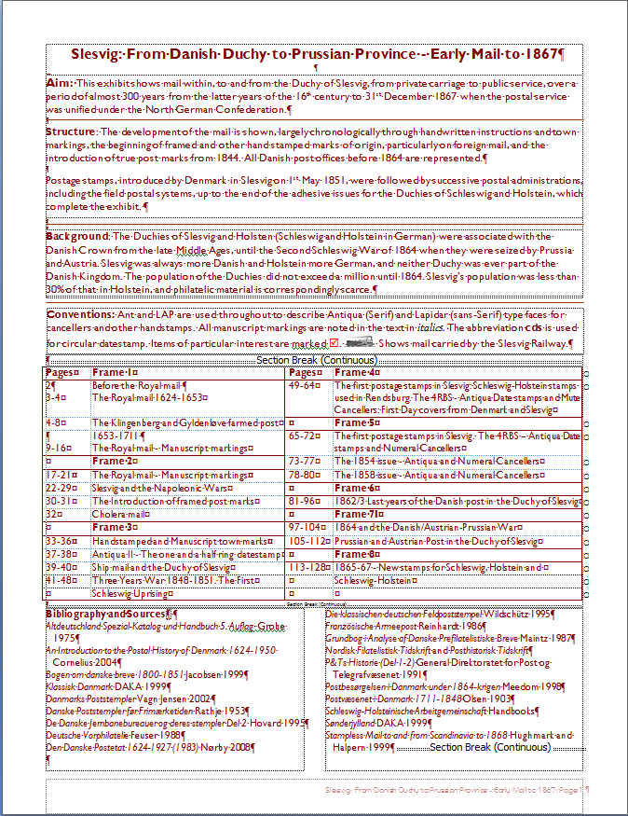
Title
The title should precisely encapsulate the exhibit. Not like these ...
Österreichische Internationale Korrespondenz in Europa
Wien
The old letters of Belarus
Postal History of Bosnia-Herzegovina
Postal History of Brno
Cancellations from the Danzig area
Dutch Colonies : Postal
Routes and Rates

Slide 10
Aim
What am I trying to achieve?

Slide 11
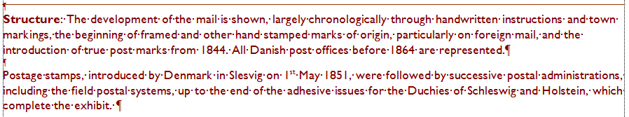
Structure
How have I put the exhibit together?
What is my beginning and end?

Slide 12
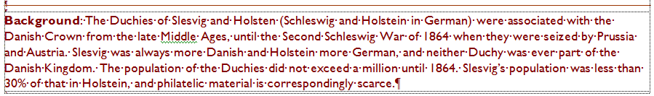
Background
What is the historical context of my exhibit?
An opportunity to deal with issues such as rarity.

Slide 13

Conventions
These are important pieces of shorthand.
They help the judge to follow
the exhibit:
Ant = Antiqua
Lap = Lapidar
Manuscript
cds = circular date stamp

Slide 14
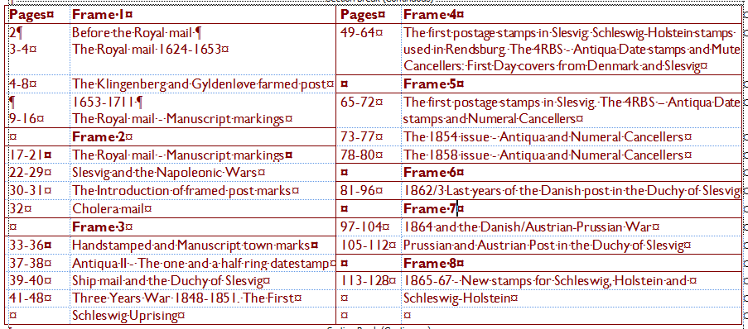
The Plan
An exact guide to the exhibit.
Go to an exhibition and watch the judges looking at an exhibit where the introductory
page is inadequate.

Slide 15
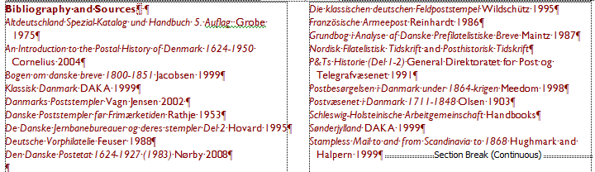
The Bibliography
Not every book on the subject.
Helps to demonstrate knowledge and research and
helps the judge to plan for the exhibition.

Slide 16
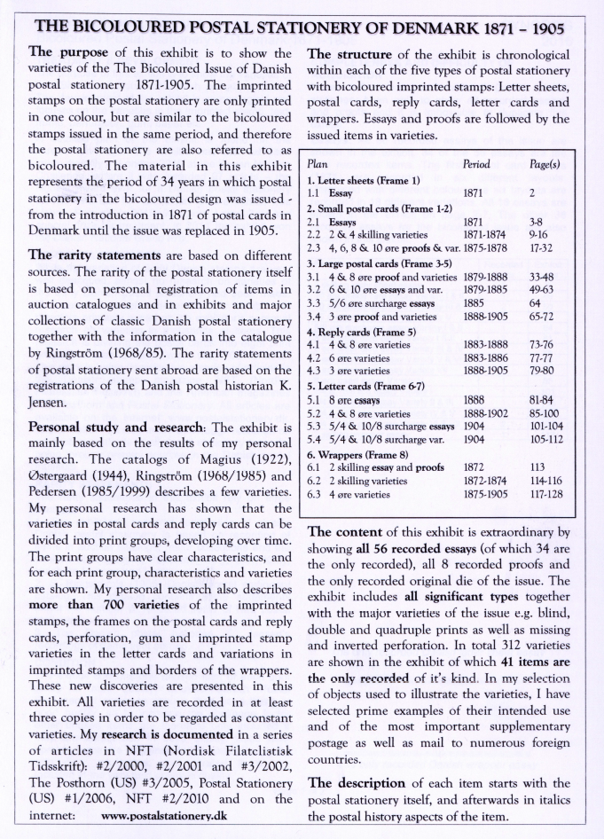
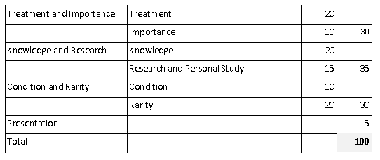

Slide 17


Slide 18
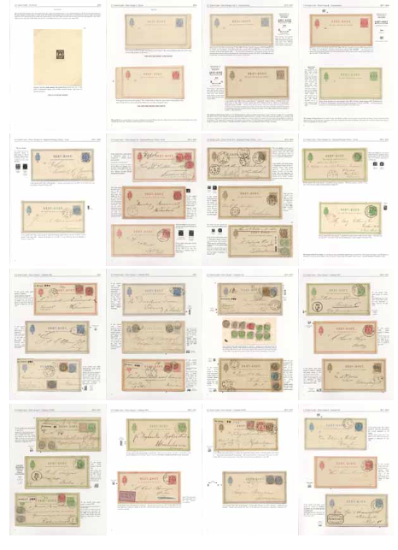

Slide 19


Slide 20
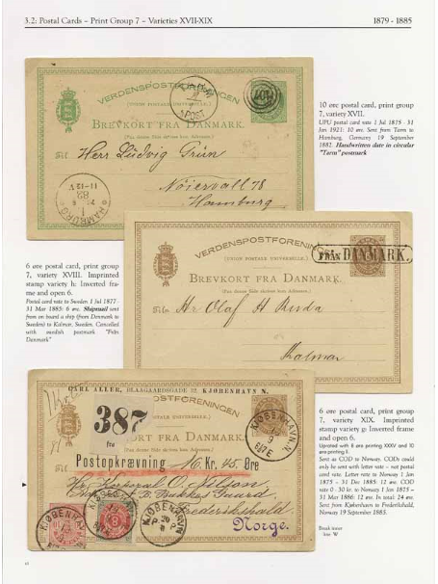
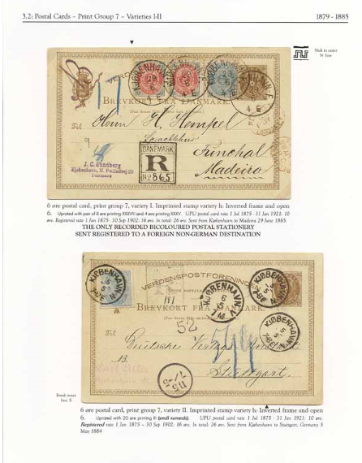

Slide 21
Treatment (20%)
Title - does it match the material
Plan and introductory page
Completeness and correctness of material – Selection of material
Does the subject fit into the space available
Originality
Balance

Slide 22
ABPS Exhibitions and International Committee
c/o The Philatelic Fund
Suite 145E, Business Design Centre
52 Upper Street
London N1 0QH
© ABPS 2016

